Slide 1
CS4632 Object Oriented Modeling and Simulation
Models with Resources
Department of Computer Science Kennesaw State University
CS4632 Object Oriented Modeling and Simulation

Slide 2
Resources
Processes are the active components of a system Resources are passive components of a system
In the process-interaction approach to simulation, resource pools need to be defined and created.
Processes can acquire several resource items from a resource pool.
CS4632 Object Oriented Modeling and Simulation

Slide 3
Model of a Warehouse System
A warehouse receives two types of trucks, small and big
trucks, that arrive periodically with goods.
Each truck needs an unloading bay to dock and unload the goods.
Small trucks need two workers to unload, and big trucks need three workers.
The warehouse has a limited number of unloading bays and a limited number of workers.
Trucks may need to wait if there are no available unloading bays and/or not sufficient available workers.
Each type of truck has a mean arrival rate and a mean unloading time interval.
CS4632 Object Oriented Modeling and Simulation

Slide 4
Components
Process definitions
Small trucks
Big trucks
Arrivals of small Trucks
Arrivals of big trucks
The main process
The simulation model of the Warehouse system consists of the following components:
Standard Resource definitions,
implemented as objects of class Res Unloading bays Workers
CS4632 Object Oriented Modeling and Simulation

Slide 5
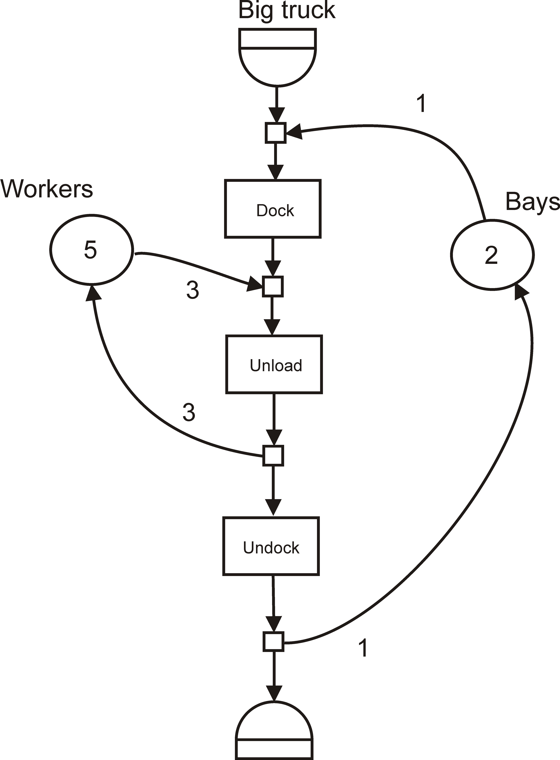
Activity Diagram of Big Truck
CS4632 Object Oriented Modeling and Simulation

Slide 6
Big Trucks
The following sequence of activities is performed by big trucks:
After arriving, acquire one unloading bay if available, otherwise, wait.
Dock into the bay, this takes a constant time interval. Acquire 3 workers if available, otherwise wait.
Unload, takes a random time interval (from a uniform distribution).
Release workers.
Undock, takes a constant time interval. Release the unloading bay.
Depart and terminate.
CS4632 Object Oriented Modeling and Simulation

Slide 7
Small Trucks
The following sequence of activities defines the behavior of small trucks.
After arriving, acquire one unloading bay if available, otherwise wait
Acquire 2 workers if available, otherwise wait
Unload, takes a random time interval (from a uniform distribution)
Release workers
Release unloading bay
Depart and terminate
CS4632 Object Oriented Modeling and Simulation

Slide 8
A Model of Machine Parts-Replacement
There are several machines in a shop, each having a part that fails periodically.
The part that fails needs to be removed from the machine, and a replacement part installed, if available.
This removal and replacement of parts is carried out by an operator.
The parts that fail are to be repaired by the repairman, who also has other jobs to carry out when not repairing parts.
CS4632 Object Oriented Modeling and Simulation

Slide 9
Detachable Resources in Model
The model includes two different resource containers, which are implemented as objects of class Bin. These resource containers are:
The parts that fail, fault_parts;
The replacement parts, rep_parts.
These are the parts that have been repaired.
CS4632 Object Oriented Modeling and Simulation

Slide 10
Activity Diagram of Machine
CS4632 Object Oriented Modeling and Simulation

Slide 11
Activities in the Model
The machine processes are producers of damaged parts; they give items to the fault_parts resource container.
The machine processes are also consumers of replacement parts; they take items from the rep_parts resource container.
The figure shows a simplified activity diagram of the machining process with the two resource containers.
The repairman process is a consumer of damaged parts; it takes items from the fault_parts resource container.
The repairman process is also a producer of replacement parts; it gives items to the rep_parts resource container.
CS4632 Object Oriented Modeling and Simulation

